Slide 1
Mobile Transaction
Dr. Sachin Tripathi

Slide 2
Mobile Database
  A database that is portable and physically separate from the corporate database server.
  Mobile Database is capable of communicating with that corporate database server from remote sites allowing the sharing of corporate database.

Slide 3
Components of a Mobile Database
Corporate Database Server
  Manages and stores corporate data, provides corporate applications
Remote Database/DBMS
  Manages and stores mobile data, provides mobile applications
Mobile Database Platform
  Laptop, PDA, etc.
Two-Way Communication Link between Corporate and Mobile Database Servers

Slide 4
Components of a Mobile Database
Communication
Link
Corporate
Server
Corporate
DB
Laptop
Mobile DBMS
Corporate
DBMS
Mobile DB
Mobile DBMS
PDA
Mobile DB

Slide 5
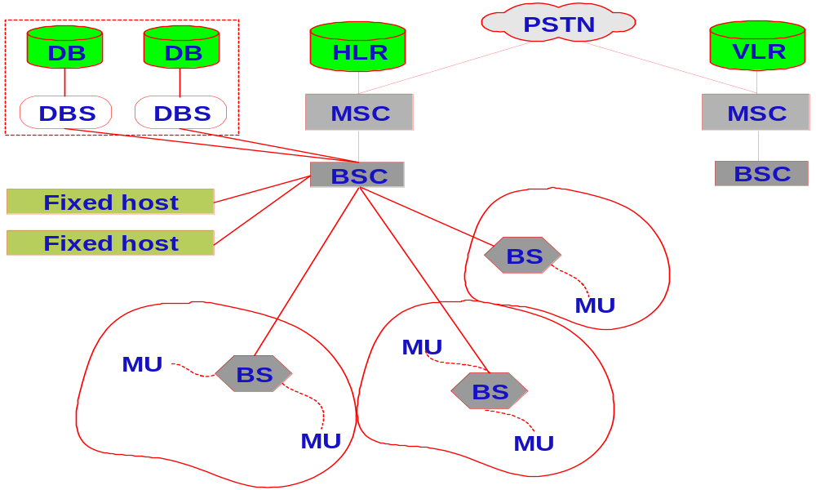
Mobile Database Integrated System

Slide 6
Requirements of a Mobile DBMS
Communicates with a centralized database server.
Replicates and Synchronizes data on the centralized server and mobile host (MH).
Can capture data from various sources such as the Internet
Manages and Analyzes the data on the MH
Can create custom mobile applications

Slide 7
Reference Model of Mobile Database
Reference model consists of three layers:
Source System
Data Access Agent
Mobile Transaction

Slide 8
Reference Model of Mobile Database
Source System
Represents a collection of registered systems that offer information services to mobile users.
Purpose – Provide services defined by specific software
Location – Fixed Host, Base Station, Mobile Unit

Slide 9
Reference Model of Mobile Database
Data Access Agent (DAA)
Purpose – Coordinate access to data in source system and facilitate recovery. Manage mobile transaction.
Location – Base Station

Slide 10
Reference Model of Mobile Database
DAA forwards transaction request of MU to the specific base stations or fixed hosts which contain the needed data and source system component.
DAA forwards all requests to one multidatabase host system which would then determine where to execute the subtransactions

Slide 11
Reference Model of Mobile Database
Each DAA contains location tables which indicate, by transaction or subtransaction, the correct MDBS (Multidatabase System) or DBMS to process the request.
When the mobile user is handed over to another base station, the DAA at the new station receives transaction information from the old base station.

Slide 12
Reference Model of Mobile Database
Mobile Transaction (MT)
The mobile user accesses data and information by issuing transactions.
Purpose – Grouping of operations needed to perform user request initiated at a Mobile Unit.
Location – Base Station, Mobile Unit

Slide 13
Reference Model of Mobile Database
Mobile Transaction is the basic unit of computation in the mobile environment
It is identified by the collection of sites (base stations) it hops through.

Slide 14
Reference Model of Mobile Database
The component of the DAA that manages the mobile transaction is called Mobile Transaction Manager (MTM).
Responsibilities - Keeping track of the execution status of all mobile transactions concurrently executing, logging recovery information, and performing needed checkpointing.

Slide 15
Transaction
  A set of operations that translate a database from one consistent state to another consistent state.
  ACID properties.

Slide 16
Transaction
The programming model of a transaction is:
Begin_transaction ()
Execution of transaction program
If (reach_final_state) then
Commit_Work(final_state)
Else
Rollback_Work(initial_state)

Slide 17
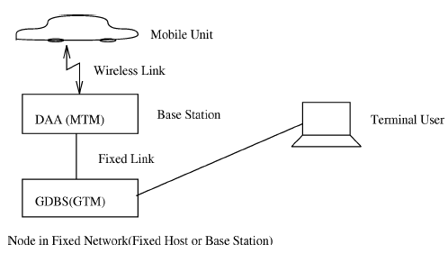
Mobile Transaction

Slide 18
Mobile Transaction
In order to properly manage a mobile transaction, the movement must be documented by the transaction controlling mechanism.
When a mobile transaction hops to a new cell, the control of the transaction may move or may remain at the originating site.

Slide 19
Mobile Transaction
Control with the originating site results to message overhead (messages would have to be sent from the originating site to the current base station any time the mobile unit requests information).

Slide 20
Mobile Transaction
Transaction management function moves with the mobile unit.
Each DAA has log information for that portion of the transaction that is executed from its site.

Slide 21
Mobile Transaction
A part of the transaction can be executed and committed independent to its other parts - Flexibility.
Difficult to enforce ACID properties in mobile transactions.
New models are being created to deal with mobile transactions

Slide 22
Mobile Transaction
Execution scenario:
MH issues transactions and the final results comes back to the same MH.
The transaction may not be completely executed at the MH so it is fragmented and distributed among database servers for execution.

Slide 23
Transaction Model
Basic Requirement
Build on existing multidatabase systems and do not duplicate support provided by a source system.
Capture movement of mobile transaction as well as data access. Move transaction control as mobile unit moves.

Slide 24
Transaction Model
Basic Requirement
Provide flexibility in terms of atomicity feature.
Support long lived transactions.

Slide 25
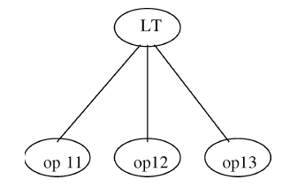
Kangaroo Transaction (KT)
Traditional transactions were a sequence of operations executed under the control of one DBMS.
Local Transaction (LT) to some DBMS

Slide 26
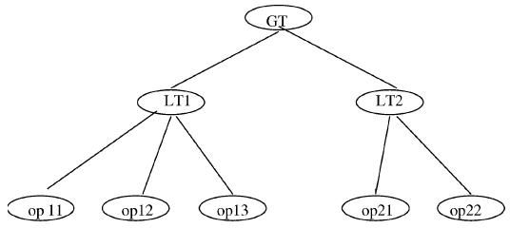
Kangaroo Transaction (KT)
Limited view of Global Transactions (GT)
The local transactions are often called subtransaction (or Global SubTransaction, GST) of the GT.

Slide 27
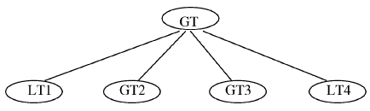
Kangaroo Transaction (KT)
Global Transaction view
The subtransactions may themselves be GTs to another multidatabase system.

Slide 28
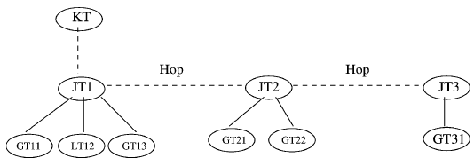
Kangaroo Transaction (KT)
Global transactions view serve as the basis.

Slide 29
Kangaroo Transaction (KT)
Based on the hopping property, the model of mobile transactions is named as Kangaroo Transactions (KT).
When a transaction request is made by a MU the DAA at the associated base station creates a mobile transaction (MT).

Slide 30
Kangaroo Transaction (KT)
A Kangaroo Transaction ID (KTID) is created to identify the transaction.
KTID = Base Station ID + Seq. No.
Each subtransaction represents the unit of execution at one base station and is called a Joey Transaction (JT).

Slide 31
Kangaroo Transaction (KT)
Pouch - The sequence of GTs and LTs which are executed under a given KT.
When the MU hops from one cell to another, the control of the KT changes to a new DAA at another base station.
The DAA at the new base station site creates a new JT.

Slide 32
Kangaroo Transaction (KT)
Joey Transaction ID (JTID) = KTID + Seq. No.
The old JT will commit independently of the new JT.
At any time, the failure of a JT may cause the entire KT to be undone.

Slide 33
Kangaroo Transaction (KT)
To manage the KT execution and recovery, a doubly linked list is maintained between the base station sites involved in executing a KT.

Slide 34
Kangaroo Transaction (KT)
To complete a partially completed KT, this linked list is traversed in a forward manner.
To undo a KT the linked list is traversed in a backward manner starting at the current JT base station site.

Slide 35
Kangaroo Transaction (KT)
Processing Modes for KTs:
Compensating Mode
Split Mode

Slide 36
Kangaroo Transaction (KT)
Compensating mode
The failure of any JT causes the current JT and any preceding or following JTs to be undone.
Previously committed JTs will have to be compensated for.

Slide 37
Kangaroo Transaction (KT)
Split mode
When a JT fails no new global or local transactions are requested as part of the KT.
The decision as to commit or abort currently executing ones is left up to the component DBMSs.

Slide 38
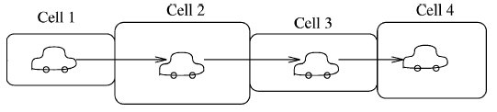

Kangaroo Transaction (KT)

Slide 39
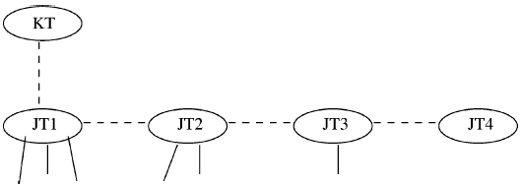
Kangaroo Transaction (KT)

Slide 40
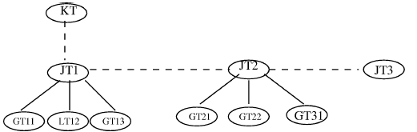
Kangaroo Transaction (KT)
The same transaction requested at two different times could have different structures.

Slide 41
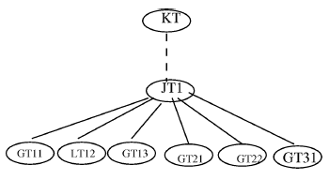
Kangaroo Transaction (KT)
Short lived or slow mobility transaction

Slide 42
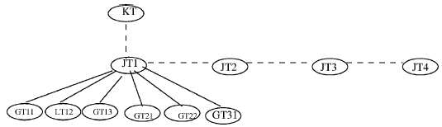
Kangaroo Transaction (KT)
Long lived or fast mobility transaction

Slide 43
Kangaroo Transaction (KT)
Two Kangaroo Transactions are Equivalent if they have the same pouch.
The user does not request the next subtransaction until the previous one is completed.
The local and global transactions under JT1 will all occur before those in JT2.

Slide 44
Kangaroo Transaction (KT)
Definition 1:
A Local Transaction LT is a sequence of read and write operations ending in either a commit or abort operation.
Definition 2:
A Global Transaction GT is any sequence of GTs and LTs.

Slide 45
Kangaroo Transaction (KT)
Definition 3:
A Joey Transaction JT is a sequence of zero or more GTs and LTs followed by either a commit, abort, or split operation.
Definition 4:
A Kangaroo Transaction KT is a sequence of one or more JTs. The last JT must end in a commit or abort. All JTs other than the last one must end in a split.

Slide 46
Kangaroo Transaction (KT)
Definition 5:
The sequence of LTs and GTs which belong to a KT is called its Pouch.
Definition 6:
Two KTs are said to be Equivalent KTs if they have exactly the same pouch.

Slide 47
Kangaroo Transaction (KT)
Mobile Transaction Manager data structures
The functions of the MTM are related to managing a mobile transaction.
The primary data structure at each site which is used to do this is the transaction status table.

Slide 48
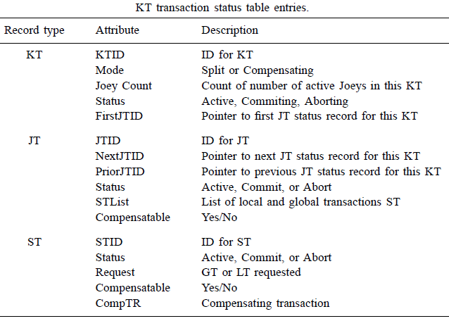
Kangaroo Transaction (KT)

Slide 49
Kangaroo Transaction (KT)
Each BS maintains a local log into which the MTM writes records needed for recovery purposes.
The log however is stored in stable storage in the base station.
Most of these records are related to the transaction status entries.

Slide 50
Kangaroo Transaction (KT)
During handoff processing the log buffer must be flushed to ensure recoverability if a failure occurs during the handoff process.
When (after) a Kangaroo Transaction is started a BTKT (Begin Trans. KT) record is written to the log.

Slide 51
Kangaroo Transaction (KT)
During handoff processing (before), an HOKT (HandOff KT) record is written into the originator’s (Base Station requesting handoff) log while a CTKT (ConTinuing KT) record is written into the destination’s (Base Station being handed off to) log (after).

Slide 52
Kangaroo Transaction (KT)
Joeys are documented in the log with a Begin (BTJT) record and a Commit (ETJT) record.
BTJT records are linked together in reverse order of creation while ETJT records are linked together in forward order of creation.

Slide 53
Kangaroo Transaction (KT)
Subtransactions within a joey have begin (BTST) and end (ETST) records.
BTST records contain the actual local/global transaction requested and the compensating transaction if the KT is compensatable.

Slide 54
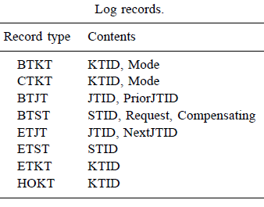
Kangaroo Transaction (KT)

Slide 55
Kangaroo Transaction Processing
STEP 1:
A MU issues a KT.
The corresponding DAA passes the transaction to its MTM to generate a unique identifier (KTID).
Creates an entry in the transaction status table.
The MTM also creates the first JT to execute locally in its communication cell.
A BTKT record is written into the MTM transaction log.

Slide 56
Kangaroo Transaction Processing
STEP 2:
The creation of a JT involves generating a unique JTID.
Creates an entry in the transaction status table.
The count of number of active Joeys in the KT status table entry is incremented by 1.
A BTJT record is then written into the log.

Slide 57
Kangaroo Transaction Processing
STEP 3:
The KT is executed in the context of JTs.
For each JT, translation is made to map the KT operations into specific source system GTs and LTs.
Based on the translation results, an ST entry is created in the transaction status table for each native (LT & GT) transaction.
A log record, BTST, is written in the MTM log before shipping each native transaction to the appropriate source system DBMS or GDBS.

Slide 58
Kangaroo Transaction Processing
STEP 4:
When network-level handoff occurs, the DAA respond by initiating a transaction-level handoff protocol.
DAA starts executing a split operation at the origination site.
DAA writes an HOKT record in the log to indicate that a handoff has taken place.
The log buffer is flushed to the stable log on disk.
These actions represent a checkpoint operation. Notice that STs may still be executing at the source system sites.

Slide 59
Kangaroo Transaction Processing
STEP 5:
The destination BS then initiates the other part of the split operation.
A CTKT record is logged after a new JT is created.
In addition, a KT entry is placed in the destination’s status table.

Slide 60
Kangaroo Transaction Processing
STEP 6:
To ensure the atomicity of the source system DBMS and GDBS systems, they will determine when to commit or abort the STs.
When the DAA is notified (by the DBMS or GDMS) that a ST has been committed, the DAA writes an ETST record in the log.
If the KT processing mode is Split, then the ST entry in the transaction status table is removed.
If the KT mode is Compensating, this entry remains in case the KT is later aborted and the compensating transaction must be executed.

Slide 61
Kangaroo Transaction Processing
STEP 6:
The STList in the transaction status table is updated to reflect the fact that this ST has committed.
If there are no active STs for this Joey, then a ETJT record is written to the log and the status of the JT status table entry is changed to commit.
The count for number of active Joeys in KT record is decremented by 1.
If the Joey count is 0 and the status of the KT is Commit, then the KT is committed.

Slide 62
Kangaroo Transaction Processing
STEP 7:
When the MU indicates that the transaction has ended, the status entry for the KT is changed to Commit.
At this time, if the active Joey count is 0 the KT is committed.

Slide 63
Kangaroo Transaction Processing
STEP 8:
To commit a KT the ETKT entry is written to the log and all status table entries for all involved BSs are freed.

Slide 64
Kangaroo Transaction Processing
Logging and recovery
The MU requests a transaction through base station 1 (BS1).
As a result a KT (BS1.1), a JT (BS1.1.1), and ST (BS1.1.1.1) are created.

Slide 65
Kangaroo Transaction (KT)

Slide 66
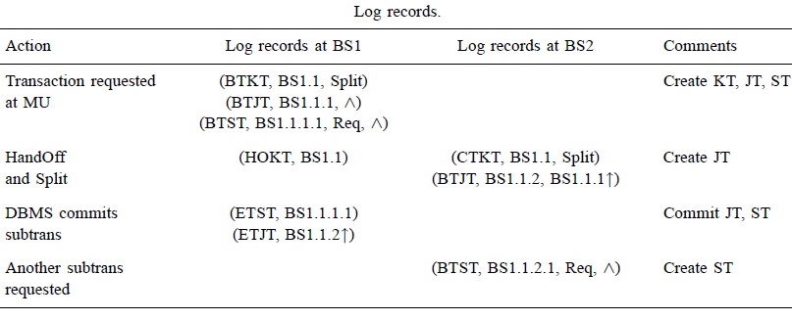
Kangaroo Transaction Processing
Logging and recovery

Slide 67
Team Transaction model
Designed to deal with mobile transactions in Ad hoc networks
Team Transaction consists of three entities:
1) Coordinator
2) Players
3) Data Access Agent (DAA)
These entities form a cluster.

Slide 68
Team Transaction model
Coordinator is captain of the team and responsible for coordinating the operations of transactions.
Players carry the operations of STs assigned by coordinator.
DAA provides database access, maintains log information for recovery, and keeps track of the coordinator and selects new coordinator in case of crash.

Slide 69
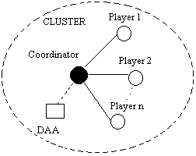
Team Transaction model

Slide 70
Database Update to Maintain Global Consistency
Database update problem arises when MUs are also allowed to modify the database.
To maintain global consistency an Efficient Database Update Scheme is necessary.

Slide 71
Transaction Commit
  An efficient commit protocol is necessary.
  2-phase commit (2PC) or 3-phase commit (3PC) is not good because of their generous messaging requirement.
  A scheme which uses very few messages, especially wireless, is desirable.

Slide 72
Timeout Based Protocol
  One possible scheme is “timeout” based protocol.
  MH and DBSs guarantee to complete the execution of their fragments of a MT within their predefined timeouts.
  During processing, no communication is required.
  At the end of timeout, each node commit their fragment independently.

Slide 73
Transaction Commit On Timeout (TCOT)
  Coordinator: Coordinates transaction commit.
  Home MH: MT originates here.
  Commit set: Nodes that process MT (MH + DBSs).
  Timeout: Time period for executing a fragment.

Slide 74
Transaction Commit On Timeout (TCOT)
  MT arrives at Home MH.
  MH extract its fragment, estimates timeout, and send rest of MT to the coordinator.
  Coordinator further fragments the MT and distributes them to members of commit set.
  MH processes and commits its fragment and sends the updates to the coordinator for DBS.
  DBSs process their fragments and inform the coordinator.
  Coordinators commits or aborts MT.

Slide 75
Transaction Recovery
Complex for the following reasons
  Some of the processing nodes are mobile
  Limited wireless channels
  Limited power supply
  Disconnected processing capability

Slide 76
Transaction Recovery
Desirable Recovery features
  Independent recovery capability
  Efficient logging and checkpointing facility
  Log duplication facility

Slide 77
Transaction Recovery
When executing transactions, it is necessary to maintain logs.
A MH is highly vulnerable to failures.
In order to recover from failures, it is necessary to store data objects and their logs at the Mobile Service Stations (MSS) rather than on MH.
A MH transfers a transaction’s execution to the MSS by moving all the pre-write values and the log records.
A separate pre-commit log is maintained for each transaction.

Slide 78
Transaction Recovery
Each log record contains the description of the pre-write values.
These are appended to the pre-commit record of a transaction.
For every pre-commit transaction, the pre-commit log records for that transaction are stored on the disk as well as in the system log at MSS.
In case a MH moves to a different cell, it append a record indicating its next possible destination.
When MH arrives at the new cell, it can continue the post pre-commit operations.

Slide 79
Transaction Recovery
Once a transaction’s execution is successfully shifted (along with all prewrite logs and pre-commit log) to the MSS, a MH may delete all the log records and keep only pre-write values in main memory for further processing.
This way it can gradually discard entries in pre-write logs.
To build highly reliable systems, these logs can also be replicated in various cells (MSS) by moving MH.

Slide 80
Transaction Recovery
At MSS, pre-write logs, pre-commit log record, write logs and final commit log record are stored.
If a pre-committed transaction fails at the stationary host, the transaction can be restarted from the point of failure.
In case of a system crash, the pre-write logs can be used to build the system’s state as it existed at the time of pre-commit.

Slide 81
Transaction Recovery
Write logs can help to bring the system to the state as it existed at the time of failure with the help of recovery algorithms.
The transaction table for active transactions are kept at MSS.
In case, the transaction starts its execution at MH then a part of the transaction table is also maintained at MH until the transaction’s execution is shifted to the MSS.
Dirty-data object table is kept at MSS. This table contains information about those objects whose final values are inconsistent with the stable database on the disk.

Slide 82
Transaction Recovery
This also keeps information about those data objects whose pre-write values announced by the pre-committed transactions have not been updated in the database before system crash.
In case of a system crash, only the redo of those pre-write and write values will be performed whose effects are not there on stable storage.
There is no need for undo pass of the recovery algorithm as data objects are updated only after the transaction is pre-committed.

